Slide 1


Advanced Section #4: Recurrent Neural Networks: Exploding, Vanishing Gradients & Reservoir Computing
AC 209B: Data Science 2
Marios Mattheakis Pavlos Protopapas

Slide 2
Outline
Exploding and Vanishing Gradients
Reservoir Computing RNN

Slide 3
Outline
Exploding and Vanishing Gradients
Reservoir Computing RNN

Slide 4
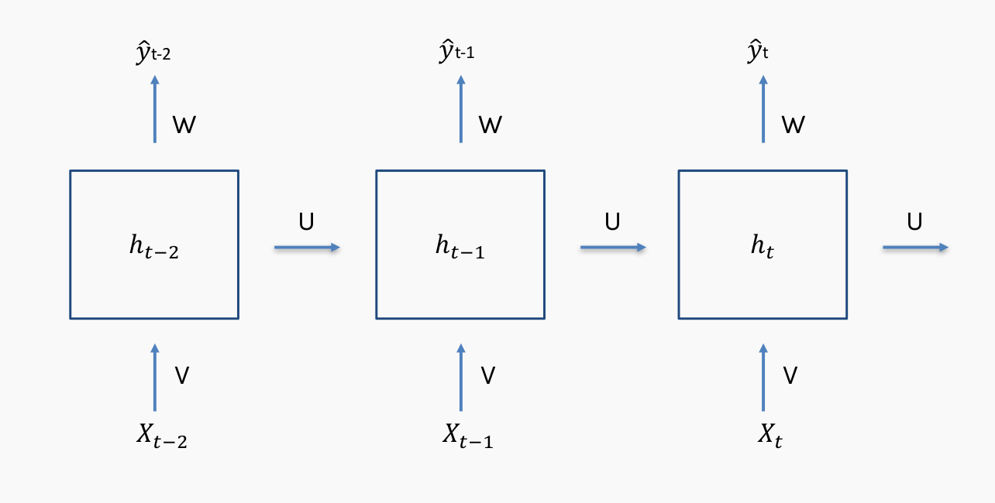
Training an RNN
The training is extremely difficult due to the recurrent connections

Slide 5
Training an RNN
As we multiply the same matrix (h) in each time in forward, we have to do the same in the back propagation
Notes:
The gradients flow through the network backwards

Slide 6
Training an RNN
As we multiply the same matrix (h) in each time in forward, we have to do the same in the back propagation

Slide 7
Training an RNN
As we multiply the same matrix (h) in each time in forward, we have to do the same in the back propagation

Slide 8
Training an RNN
The first update of the gradients will be fine. But, as we are going further back in time the signals (gradients) might become too strong or too weak

Slide 9
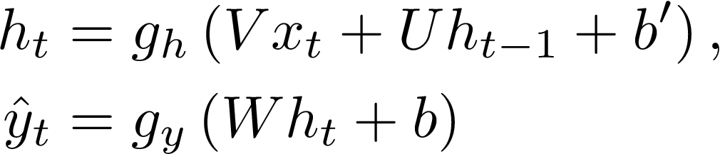
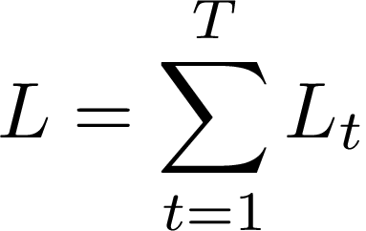
The vanishing/exploding gradient
RNN formulation
Total Loss is the sum of each loss in time
For the loss function wrt to the entire sequence in the interval t = [1,T] we need to sum up the loss function in all the time steps

Slide 10
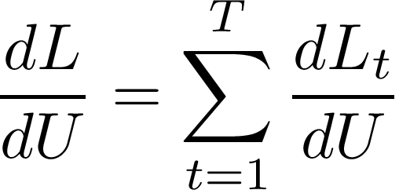
Loss minimization
Minimize the total loss wrt the recurrent weights
Let explore with chain rule just a single time step

Slide 11
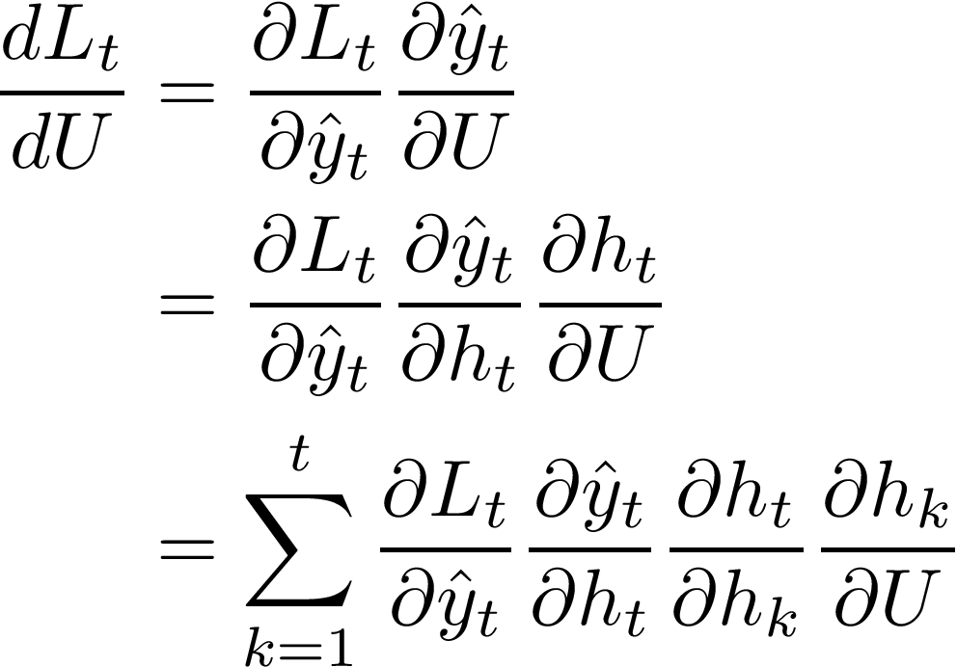
Chain rule for a single time step

Slide 12
Chain rule for a single time step

Slide 13
Chain rule for a single time step

Slide 14
Chain rule for a single time step
Even computing the gradient in one time step, it requires a huge chain rule application because it demands all the previous times steps

Slide 15
Chain rule for a single time step
Let’s explore deeper ...

Slide 16

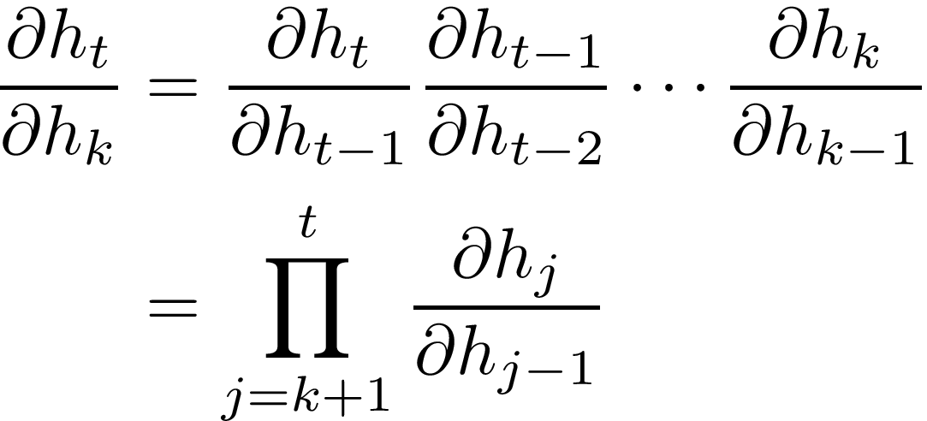
The bad term:
Chain rule again

Slide 17
The bad term:
Chain rule again

Slide 18
The bad term:
Chain rule again
Jacobian matrix of the state to state transition. The gradients is a product of Jacobian matrices (huge product)
Notes:
Derivative between vectors: Jacobian

Slide 19
The bad term:
Chain rule again
Explore further each the Jacobian matrix (almost done)
Notes:
Derivative between vectors: Jacobian

Slide 20
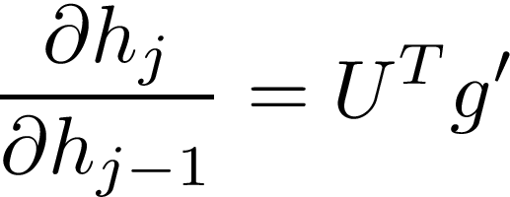
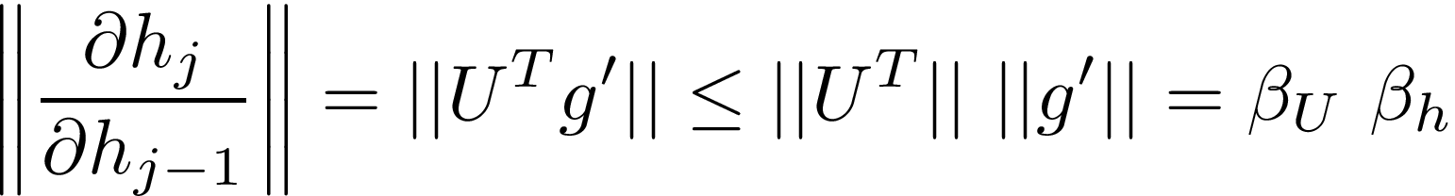
Explore the Jacobian matrices
Remind:
Hence:
The Norm:

Slide 21
Explore the Jacobian matrices
Remind:
Hence:
The Norm:

Slide 22
Explore the Jacobian matrices
Remind:
Hence:
The Norm:
Where βs are the values of the norms (numbers)

Slide 23
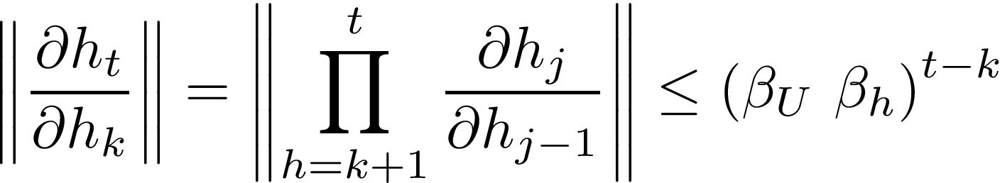

The vanishing/exploding gradient
> 1: Exploding gradients
< 1: Vanishing vanishing
It happens very fast as the time increases

Slide 24
What happens?
Vanishing gradient: Make it difficult to know in which direction to move for improving the loss function
Exploding gradient: The learning becomes unstable

Slide 25
Solutions
Clipping gradients method
Special RNN with leaky units such as Long-Short-Term-Memory (LSTM) and Gated Recurrent Units (GRU)
Echo states RNNs

Slide 26
Outline
Exploding and Vanishing Gradients
Reservoir Computing RNN

Slide 27


Reservoir Computing
The recurrent weights from hidden to hidden state and the input weights mapping to hidden are extremely difficult to be trained
An approach to avoid this difficulty is to fix the recurrent and input weights and learn only the output weights: Echo State Network (ESN)
The hidden units form a Reservoir of temporal features that capture different aspects from of the history inputs

Slide 28
Reservoir Computing
The recurrent weights from hidden to hidden state and the input weights mapping to hidden are extremely difficult to be trained
An approach to avoid this difficulty is to fix the recurrent and input weights and learn only the output weights: Echo State Network (ESN)
The hidden units form a Reservoir of temporal features that capture different aspects from of the history inputs

Slide 29
Reservoir Computing
The recurrent weights from hidden to hidden state and the input weights mapping to hidden are extremely difficult to be trained
An approach to avoid this difficulty is to fix the recurrent and input weights and learn only the output weights: Echo State Network (ESN)
The hidden units form a Reservoir of temporal features that capture different aspects from of the history inputs

Slide 30
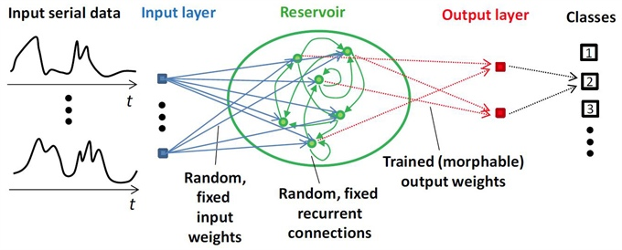



Insight description of RC
Takes an arbitrary length sequence input vector
Mapping it into a high-dimensional feature space (recurrent state )
A linear predictor (lin. regression) is applied to find

Slide 31
Speed up the training
We essentially train only the output weights:
Drastically speeds up the training
Great advantage of RC
Set and fix the input and recurrent weights to represent a rich history:
Recurrent states as dynamical systems near to the stability
Stability means Jacobians close to one
Leaky hidden units that partially remember the previous state
Avoid exploding/vanishing gradients
No need of training

Slide 32

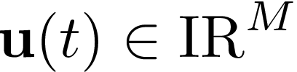
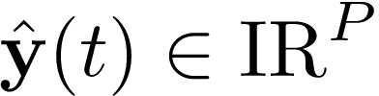
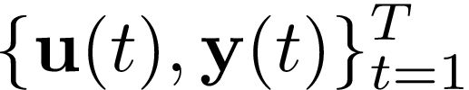
RC formulation
Looking for a functional relationship:
M given inputs:
P desired outputs:
In the training period T with training set:

Slide 33
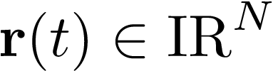
RC formulation
M given inputs:
P desired outputs:
In the training period T with training set:
Suppose a reservoir with N hidden recurrent states
Looking for a functional relationship:

Slide 34







Weights and connections
Reservoir nodes with recurrent connections:
The inputs are connected to reservoir nodes through a linear layer:
The reservoir nodes are connected with output with a linear layer:

Slide 35
Weights and connections
Reservoir nodes with recurrent connections:
The inputs are connected to reservoir nodes through a linear layer:
The reservoir nodes are connected with output with a linear layer:

Slide 36

Weights and connections
Reservoir nodes with recurrent connections:
The inputs are connected to reservoir nodes through a linear layer:
The reservoir nodes are connected with output with a linear layer:

Slide 37
Weights and connections
Reservoir nodes with recurrent connections:
The inputs are connected to reservoir nodes through a linear layer:
The reservoir nodes are connected with output with a linear layer:

Slide 38
Heuristic choice of weights
The input and recurrent weights are initialized randomly and then are fixed
So, we are not training them… boosting the training
How should we fix them to optimize the prediction? Later…

Slide 39


Dynamics of hidden states
The hidden states evolve dynamically in time as:
the leakage rate, controls the speed of evolution (leaky unit)
the activation function (usually tanh() and sigmoid)

Slide 40
Dynamics of hidden states
The hidden states evolve dynamically in time as:
the leakage rate, controls the speed of evolution (leaky unit)
the activation function (usually tanh() and sigmoid)

Slide 41
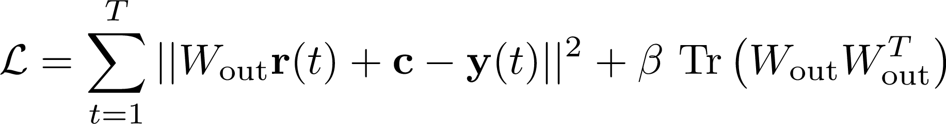

Training
Since we have the evolution of the state, a linear layers gives the output
Determine the weights and bias by minimizing the MSE loss
Linear Regression (simple!)
is a ridge regression parameter (the last is a regularization term)

Slide 42



No free lunch...
The training is very easy and fast but there are hyper-parameters
Optimize for
Hyper-parameters that govern the random generation of the weights
The degree of a reservoir nodes D:
is sparse with D/N non-zero elements
The spectral radius ρ:
The largest eigenvalue of is ρ
: initialized by a uniform distribution in the [-σ,σ]
No systematic method to optimize the hyper-parameters

Slide 43
No free lunch...
The training is very easy and fast but there are hyper-parameters
Optimize for
Hyper-parameters that govern the random generation of the weights
The degree of a reservoir nodes D:
is sparse with D/N non-zero elements
The spectral radius ρ:
The largest eigenvalue of is ρ
: initialized by a uniform distribution in the [-σ,σ]
No systematic method to optimize the hyper-parameters

Slide 44
No free lunch...
The training is very easy and fast but there are hyper-parameters
Optimize for
Hyper-parameters that govern the random generation of the weights
The degree of a reservoir nodes D:
is sparse with D/N non-zero elements
The spectral radius ρ:
The largest eigenvalue of is ρ
: initialized by a uniform distribution in the [-σ,σ]
No systematic method to optimize the hyper-parameters

Slide 45
No free lunch...
The training is very easy and fast but there are hyper-parameters
Optimize for
Hyper-parameters that govern the random generation of the weights
The degree of a reservoir nodes D:
is sparse with D/N non-zero elements
The spectral radius ρ:
The largest eigenvalue of is ρ
: initialized by a uniform distribution in the [-σ,σ]
No systematic method to optimize the hyper-parameters

Slide 46
No free lunch...
The training is very easy and fast but there are hyper-parameters
Optimize for
Hyper-parameters that govern the random generation of the weights
The degree of a reservoir nodes D:
is sparse with D/N non-zero elements
The spectral radius ρ:
The largest eigenvalue of is ρ
: initialized by a uniform distribution in the [-σ,σ]
No systematic method to optimize the hyper-parameters

Slide 47
No free lunch...
The training is very easy and fast but there are hyper-parameters
Optimize for
Hyper-parameters that govern the random generation of the weights
The degree of a reservoir nodes D:
is sparse with D/N non-zero elements
The spectral radius ρ:
The largest eigenvalue of is ρ
: initialized by a uniform distribution in the [-σ,σ]
No systematic method to optimize the hyper-parameters

Slide 48
Recap
The network nodes each have distinct dynamical behavior
Time delays of signal may occur along the network links
The network hidden part has recurrent connections
The input and internal weights are fixed and randomly chosen
Only the output weight are adjusted during the training.

Slide 49
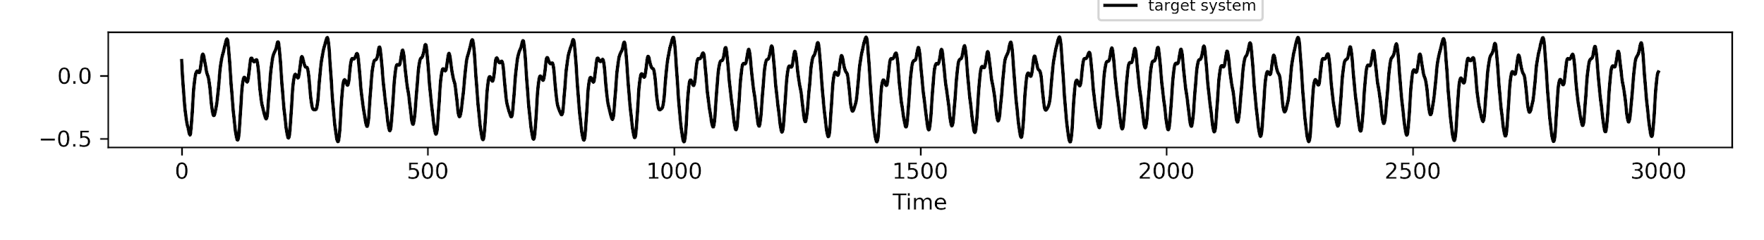
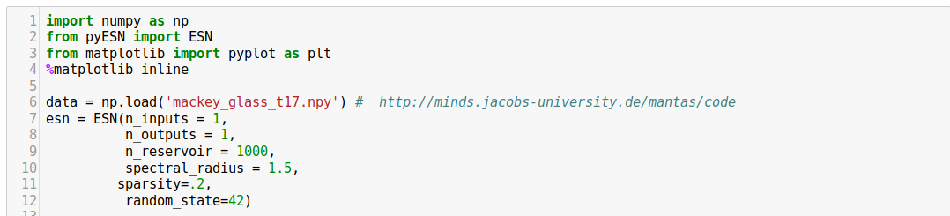
Example: Chaotic time series prediction
Data
RC implementation

Slide 50
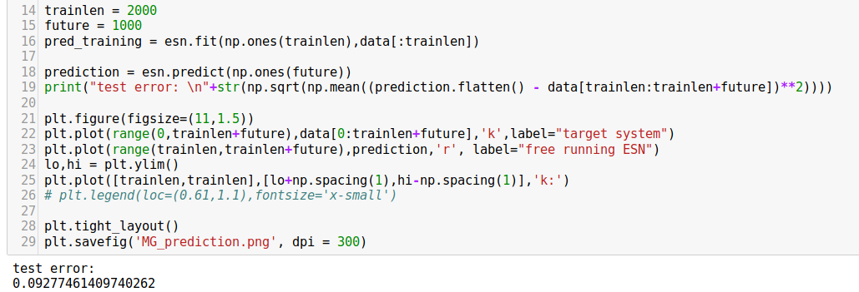
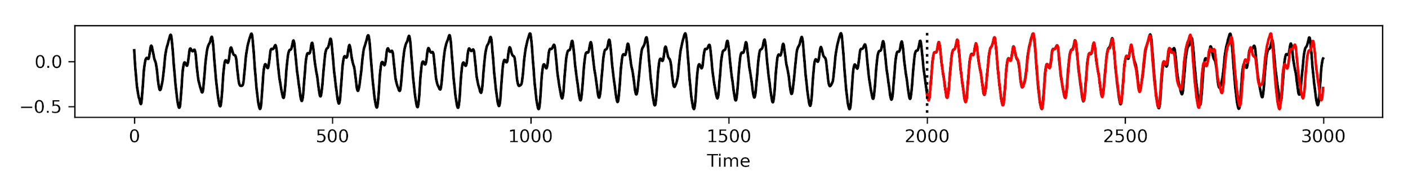
Example: Chaotic time series prediction

Slide 51
Reservoir Computing
Forecasting the weather
Controlling complex dynamical systems
Predicting and analyzing time series
Pattern recognition
more...

